Slide 1
Mini-Course in Electrical Engineering
Solar Car Electrical Systems,
Battery Technology, and Safety Issues
Brian Coleman, Advisor – Somerset HS, Somerset, KY

Slide 2
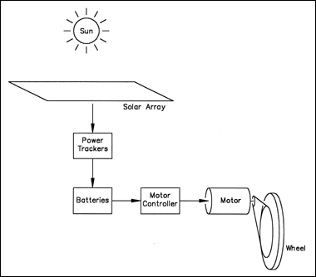
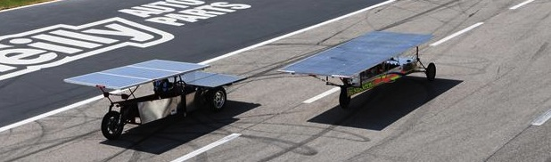
Electrical System Overview
Solar Array
Maximum Point Power Trackers
Batteries
Motors / Motor Controllers
Other Electrical Components

Slide 3
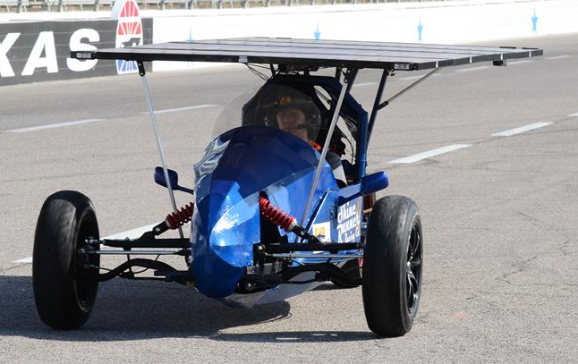
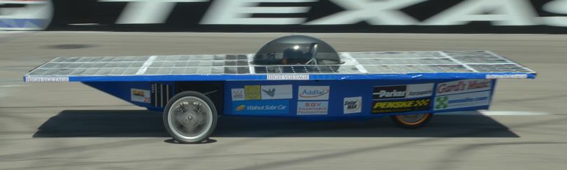
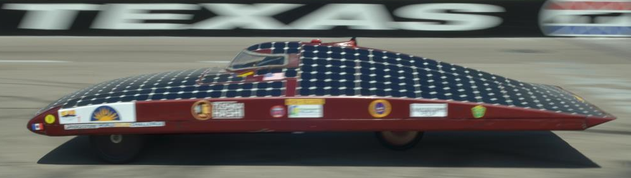
Solar Array Design Options
Flat Solar Arrays
  Easier to execute
  Angle to sun less of a concern
  Less aerodynamic
Curved Solar Arrays
  Brittle solar cells can break when flexed
  Mounting to solar car may be tricky
  Angle to sun more of a concern

Slide 4
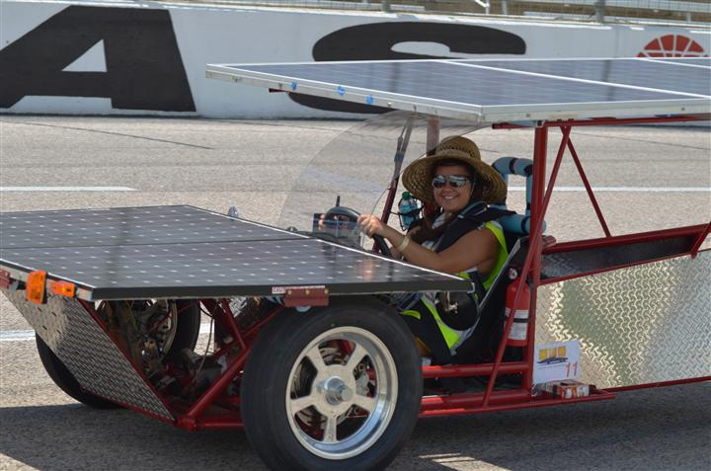
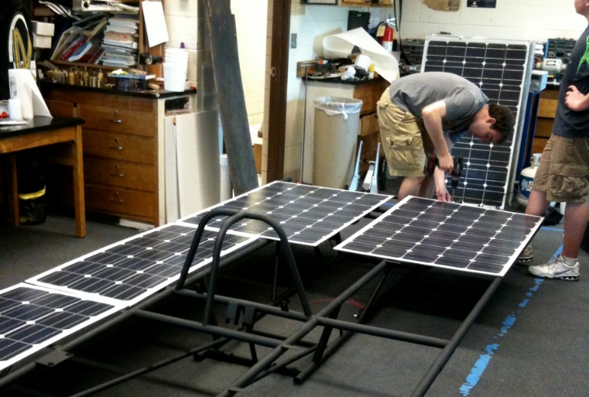

Solar Array Choices
Pre-made Commercial Panels
  Reliable
  Easily purchased
  HEAVY (glass front adds weight)
Pre-made Specialty Panels
  Lightweight option

Slide 5
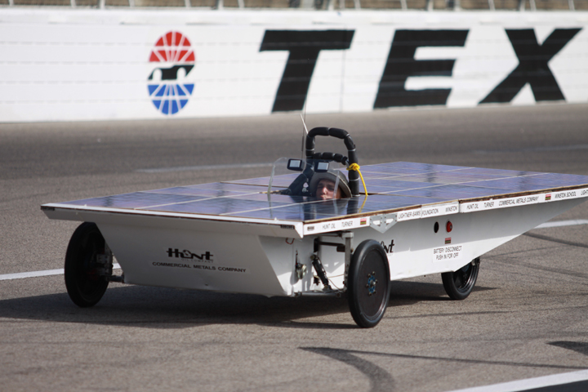
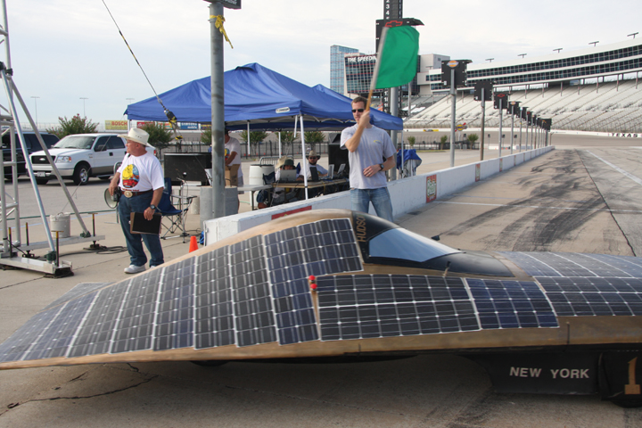

Solar Array Choices
Raw cells and lamination (e.g. custom arrays)
  Planning has to start FAR in advance (you are probably too late already!)
  Process is expensive
  Panels are very light and can be built to fit your car
  Easy to maximize power and reduce aerodynamic drag

Slide 6
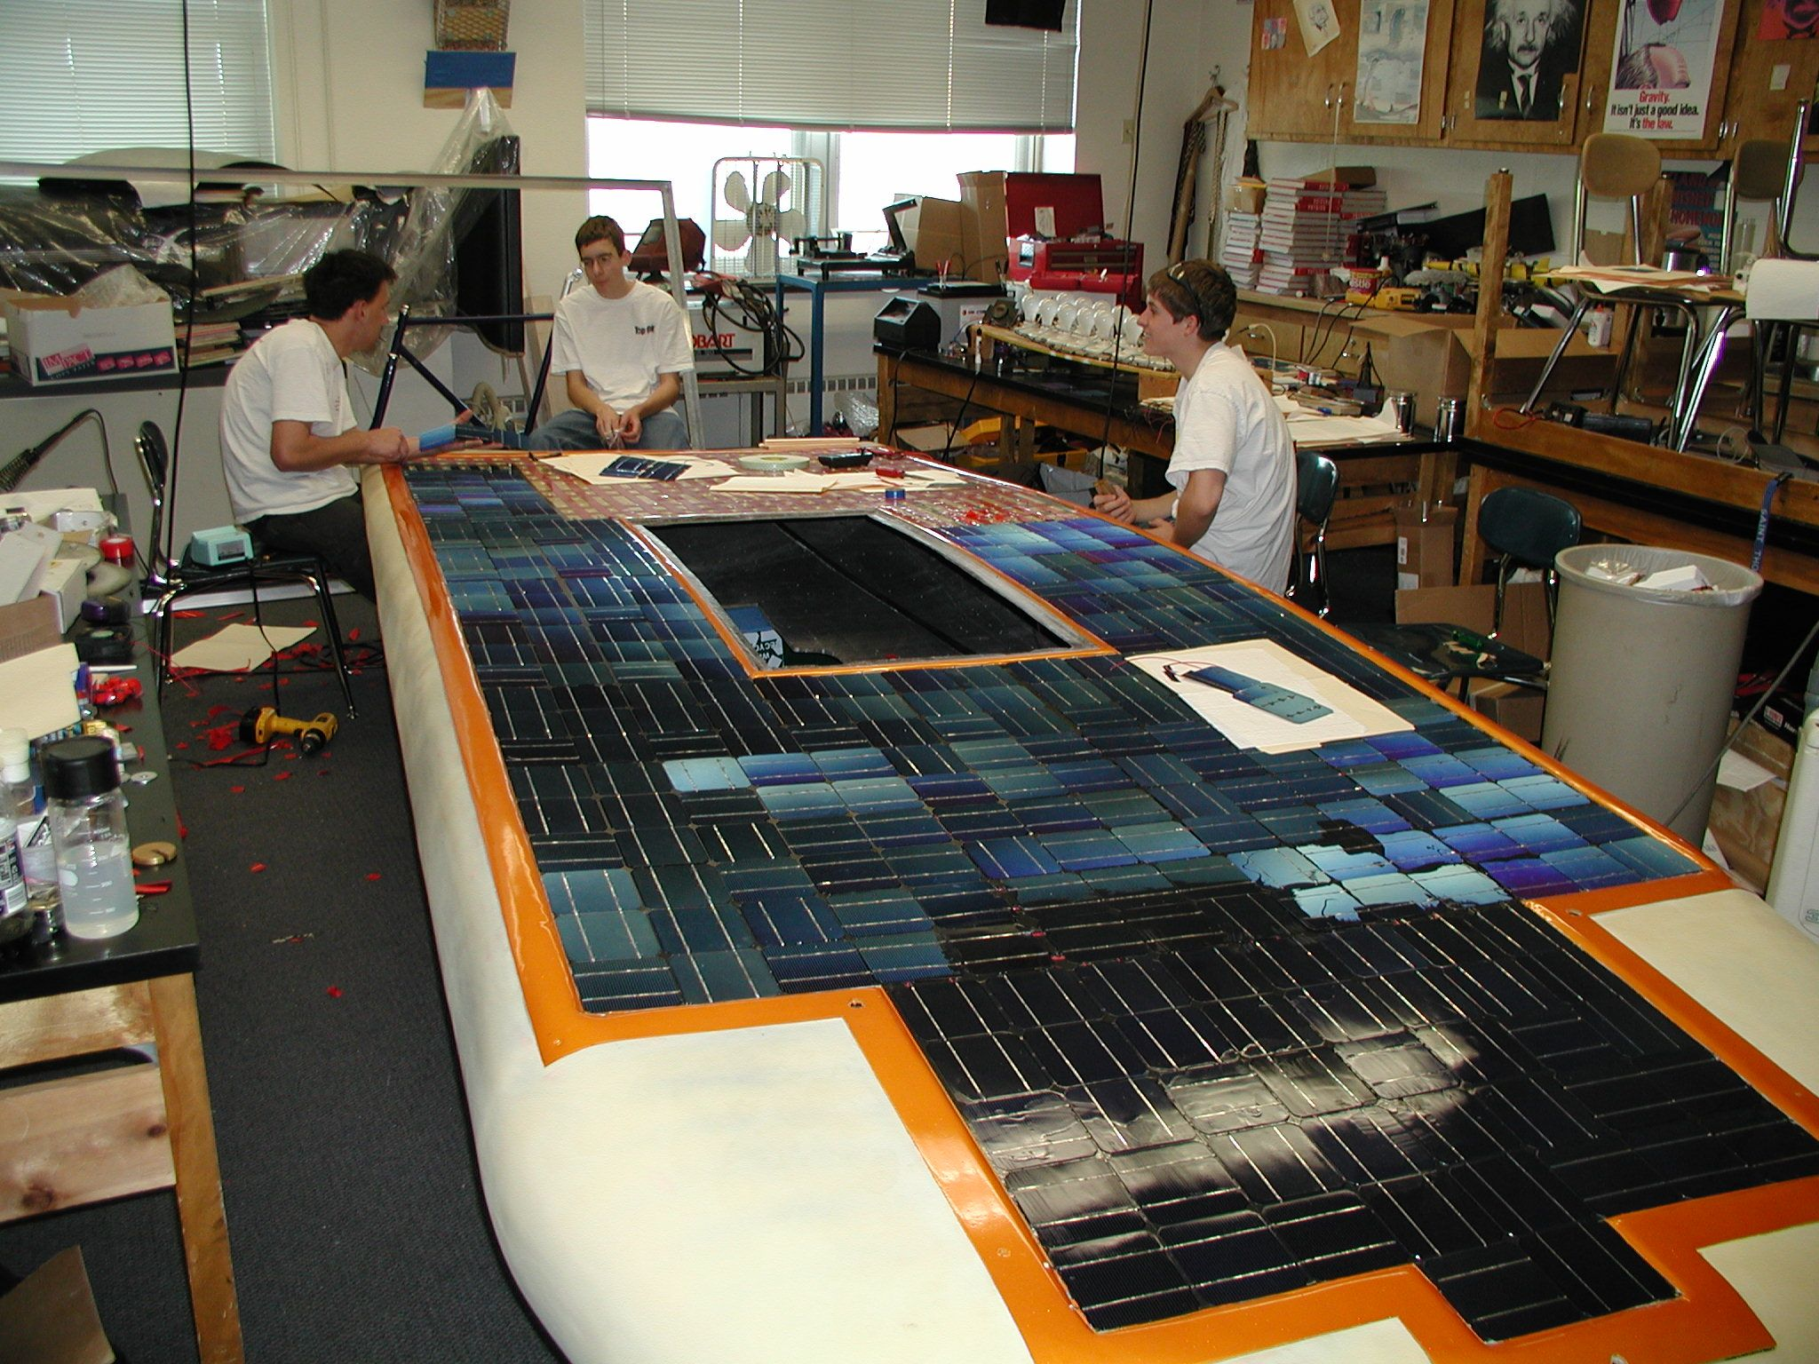
Solar Array Choices
Do-it-yourself solar array
  Amazing learning experience
  Learning curve is steep
  Hard to find raw cells (contact SunPower directly)
  Takes a lot of man power
  Hard to watch when cells are continually breaking
  Can fit exactly to your car

Slide 7
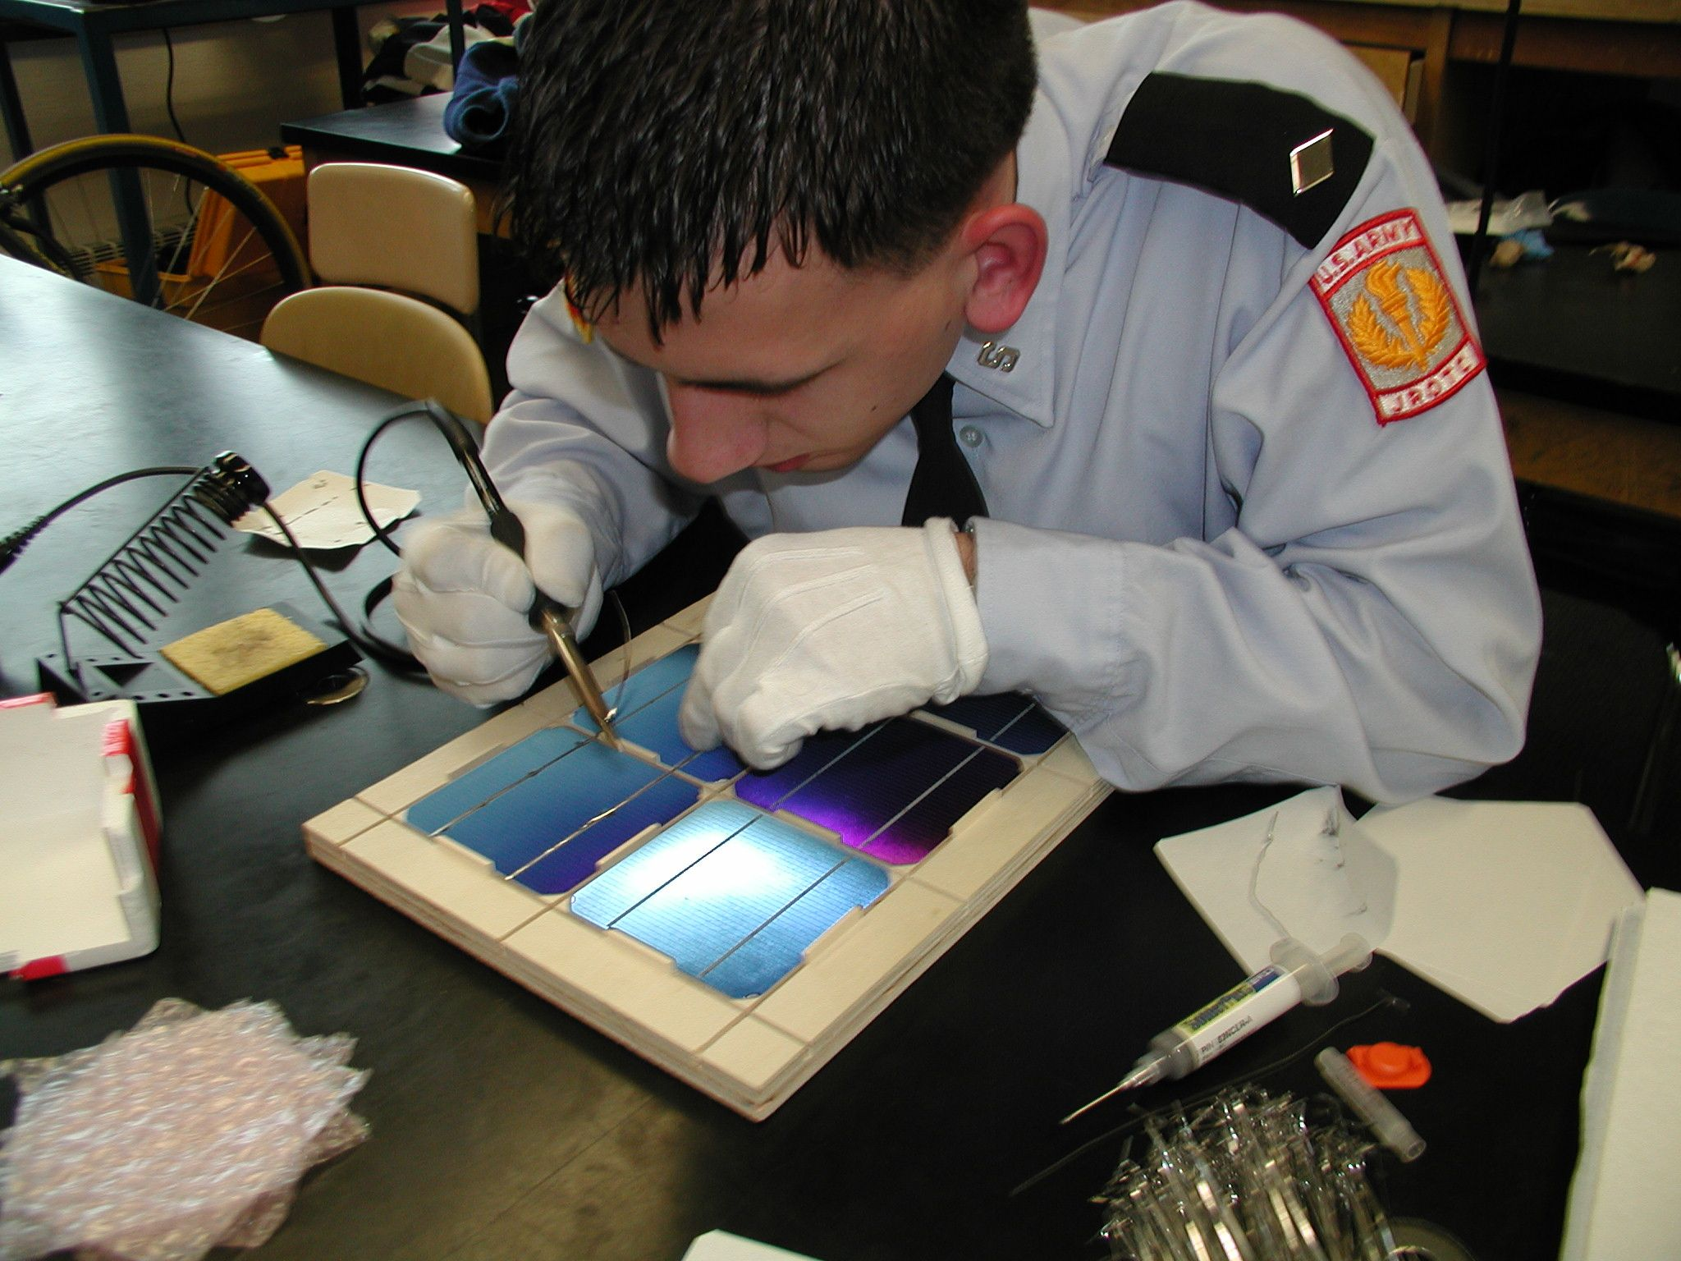
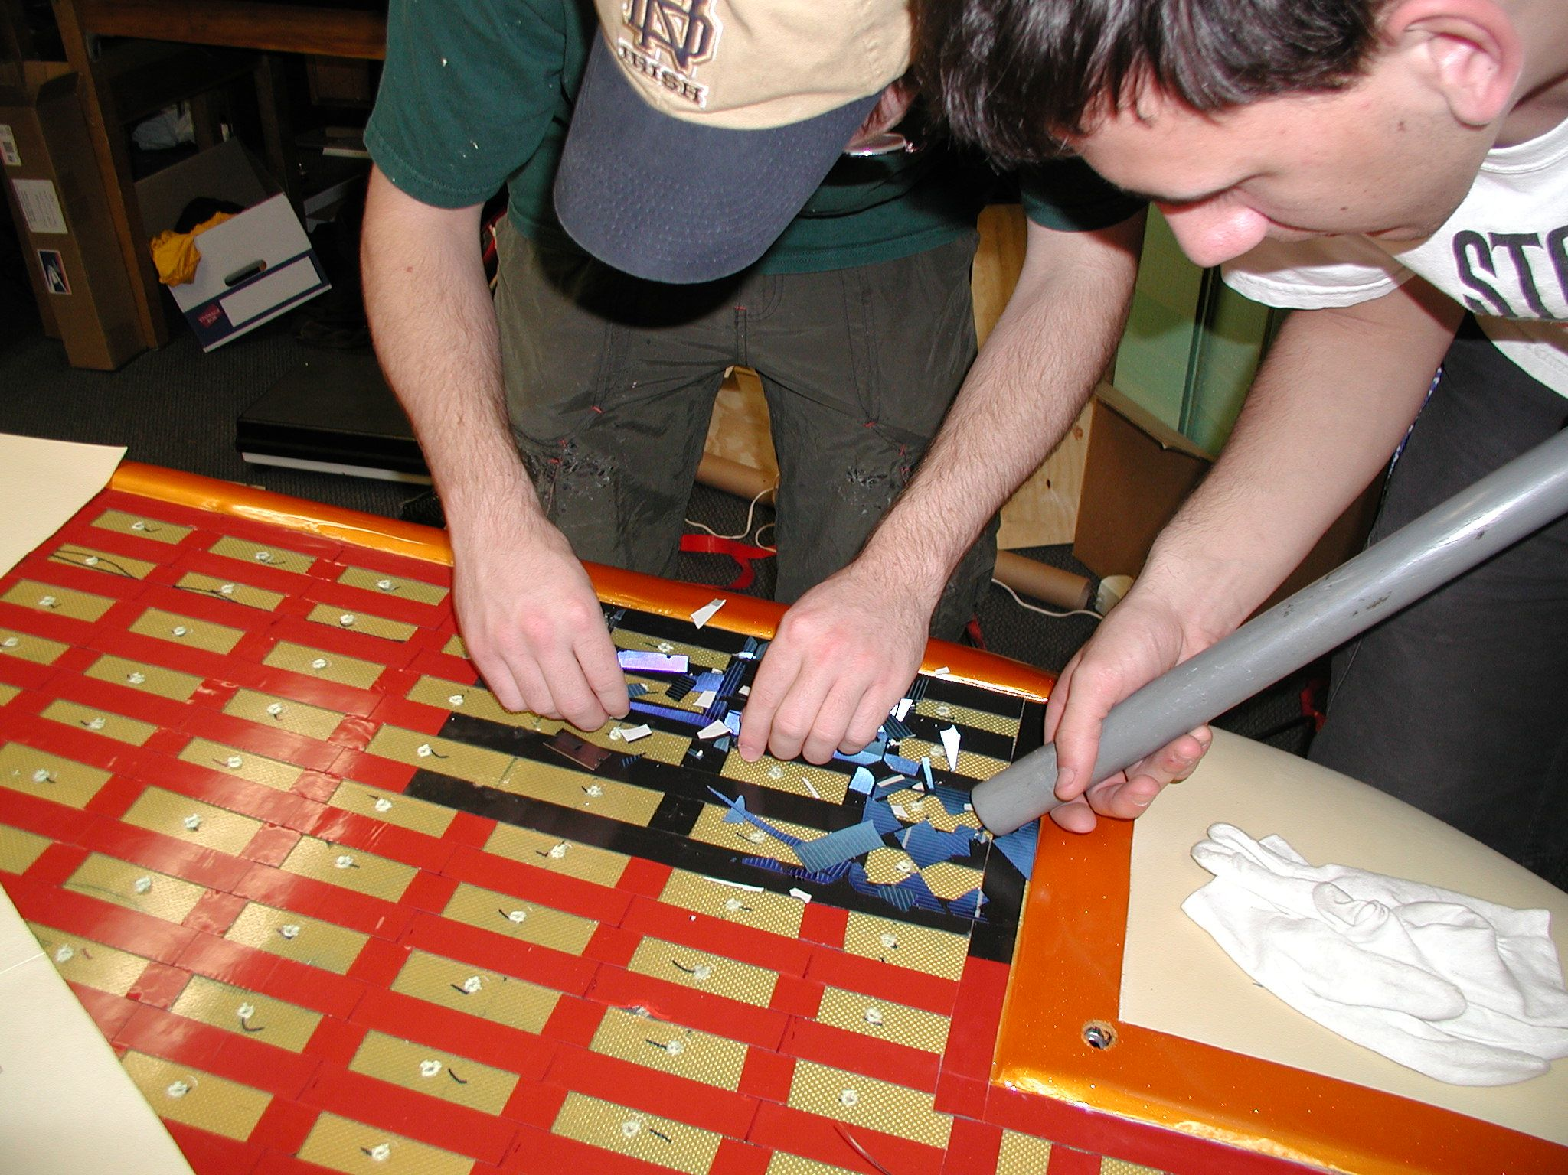
Do-it-yourself

Slide 8
Electrical System Overview
Solar Array
Maximum Point Power Trackers
Batteries
Motors / Motor Controllers
Other Electrical Components

Slide 9
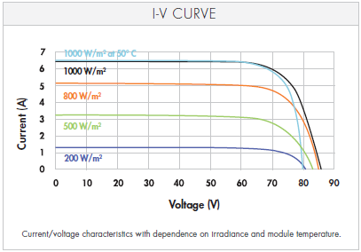
Maximum Point Power Trackers (MPPTs)
Moving power from the solar array to the batteries is not as easy as hooking up a couple of wires!
Voltage from your solar array needs to match the voltage of the battery pack.
Maximum Power Point Trackers adjust voltage and current from your array to give you the most possible power to your vehicle.

Slide 10
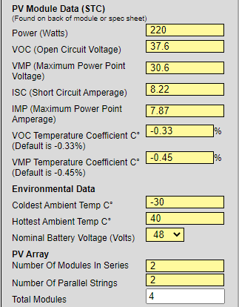
MPPT Considerations
Buck vs. Boost
  Buck = V_{out} < V_{in}
  Boost = V_{out} > V_{in}
Battery/System Voltage (V_{out})
  Greatest options for <= 48 V
  One option > 72 V (AERL)
Current (I_{SC}) or Power Rating
Efficiency: typically > 95%

Slide 11
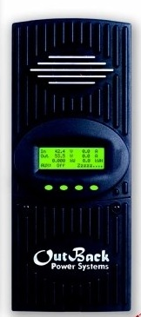
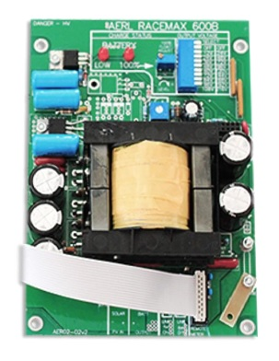
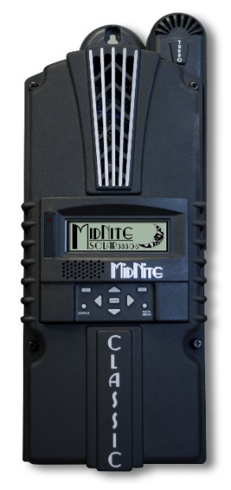
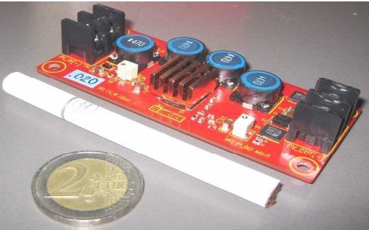
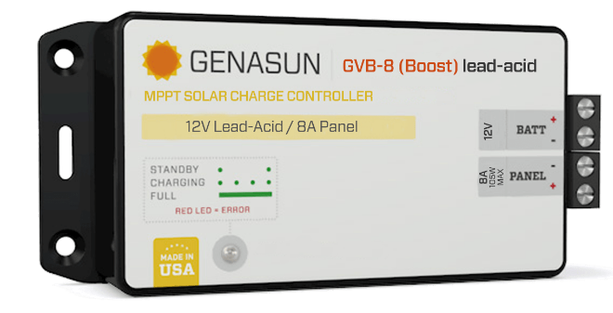
MPPT Choices
AERL (Australian Energy Research Laboratories) RaceMax 600B
  Needed for V_{out} > 72V
Nomura MPPT
  Small/light, V_{out} = 34.5V
MidNight Solar / Outback Power (and other grid type MPPTs)
Genasun
DC-DC Converters → Don’t do this!
https://www.facebook.com/NomuraCo/photos/a.2709579579286363/2709579905952997/

Slide 12
Electrical System Overview
Solar Array
Maximum Point Power Trackers
Batteries
Motors / Motor Controllers
Other Electrical Components

Slide 13
Batteries
Choose carefully!
  Batteries are one of the areas where you get what you pay for.
Decisions to make:
  What voltage does your car run at? (Higher voltage means lower current.)
  How much weight can you carry?
  How much energy can you get at that weight?
  Can your solar panels recharge the battery pack?
  Is it a road race or a track race?

Slide 14
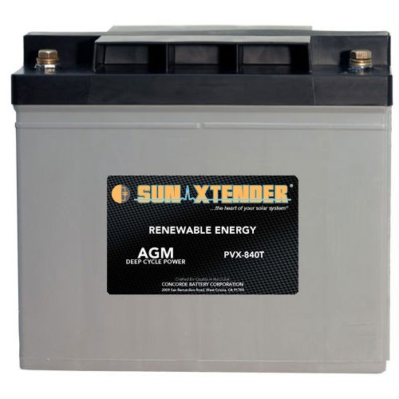
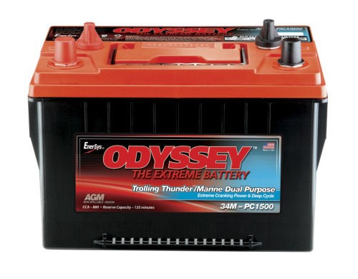
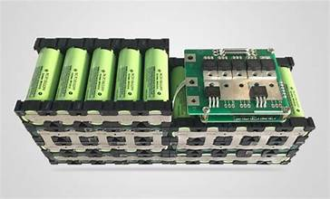
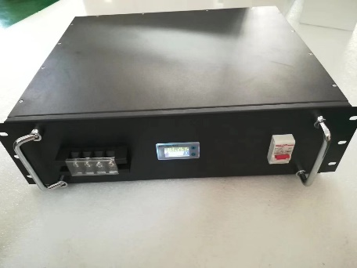
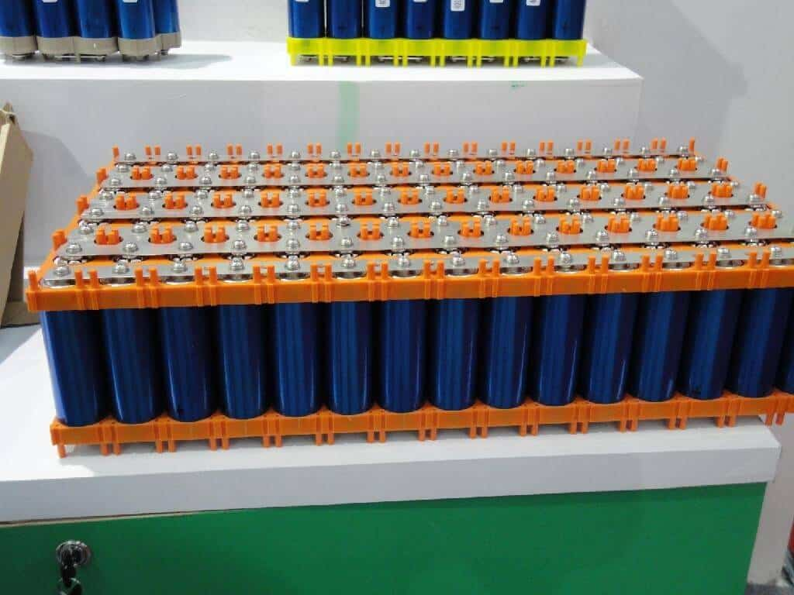
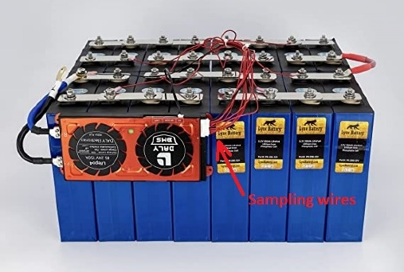
Batteries: Limits & Chemistries
Classic Division - 5.25 kWh – Lead Acid or LiFePO4
Advanced Classic Division - 5.25 kWh – Lead Acid or LiFePO4
Electric-Solar Division - 5.25 kWh (x2) – Lead Acid or LiFePO4
Advanced Division - 5.25 kWh – Any Chemistry
Cruiser Division – 10.5 kWh – Any Chemistry

Slide 15
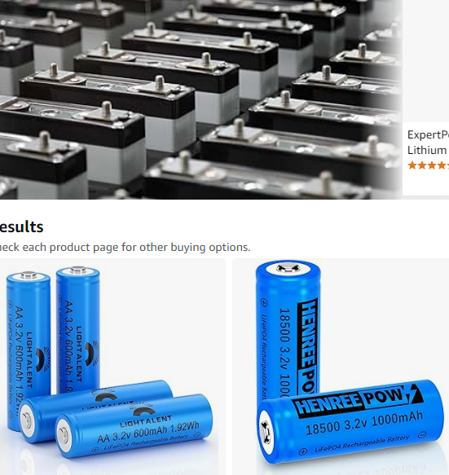
Batteries: 5.25 kWh Limit
The 5.25 / 10.5 kilowatt-hour (kWh) rule
  kWh = Amp-hours x Voltage
  Calculated at the 20 hour discharge rate or 1C
Example (Lead-Acid):
  Four, 12v, 84 amp-hour batteries in series
  84 Ah x 48 V = 4032 Wh or 4.032 kWh
  (this battery pack would weigh around 230 pounds)
Example (LiFePO4):
  One, 48v/51.2v, 100 amp-hour battery
  100 Ah x 51.2 V = 5120 Wh or 5.12 kWh
  (this battery pack would weigh around 90-115 pounds)

Slide 16
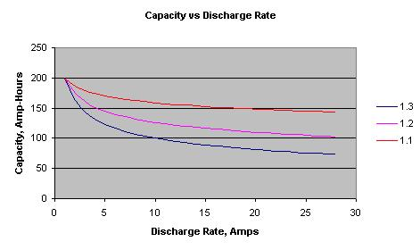
Batteries: Effect of Peukert’s Number
Choosing batteries based on the Peukert number:
  A typical sealed lead acid battery has a Peukert number between 1.1 and 1.3. (The closer to 1.0 the better!)
  Lithium chemistries are very close to 1.0.

Slide 17
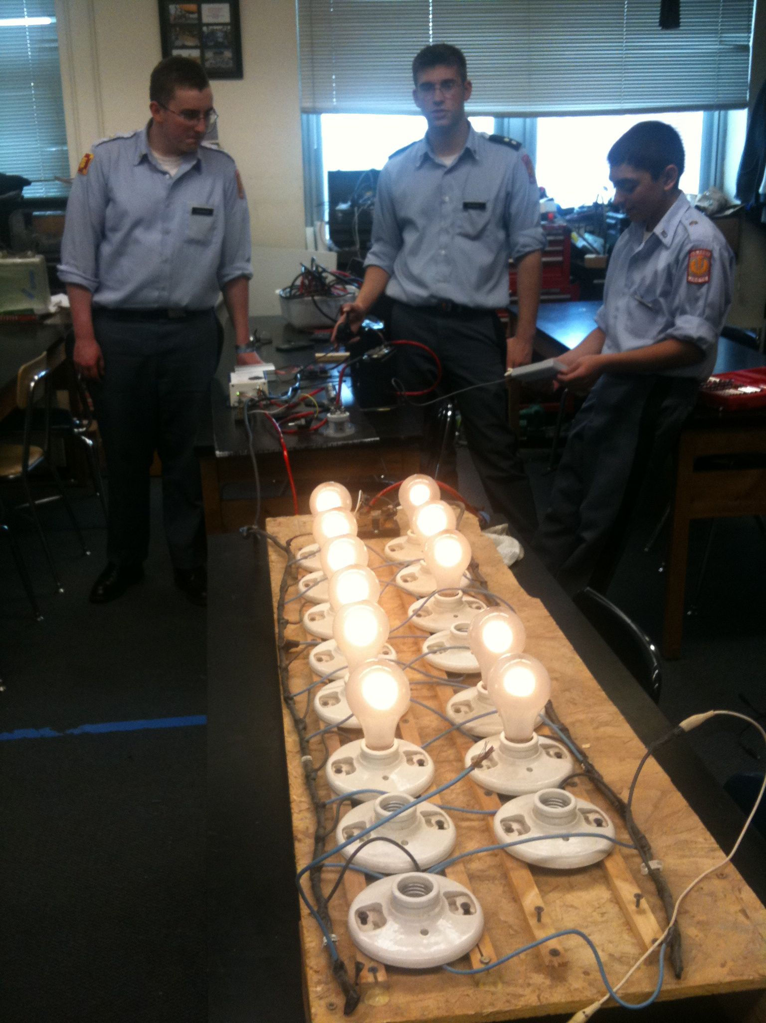
Batteries: Don’t rely on specs
Testing batteries:
  Understanding how your batteries perform is one of the most important things you can know BEFORE the race starts.
  Carefully recording voltage, current, and amp-hours will help your team make good decisions during the race

Slide 18
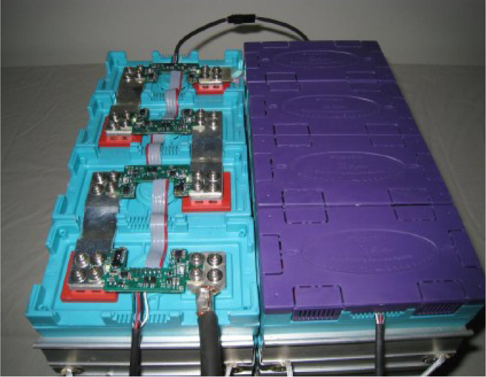
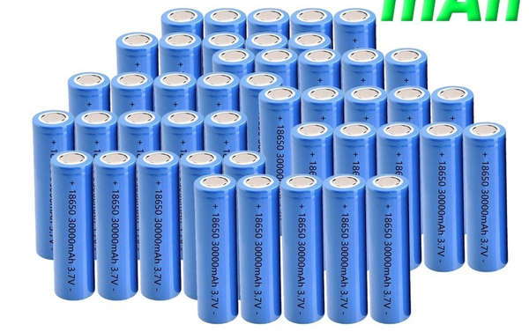
Lithium-based Chemistries
Permitted only in Advanced or Cruiser Divisions
5 kWh capacity limit calculated at 1C
Multiple Chemistry Types
  Lithium-Ion: Higher energy density (150-200 Wh/kg), lower discharge rate (1C)
  Lithium Iron Phosphate: Lower energy density (90-120 Wh/kg), higher discharge rate (1-25C), better thermal/chemical stability
Advantages:
  Better charge/discharge efficiency
  Lighter (higher energy density)
Requires Battery Management System (BMS) to prevent overcharge and overdischarge
LiFeMnPO4 Prismatic Battery
Prismatic Pouch
Individual Li-Ion 18650 Cells

Slide 19
Electrical System Overview
Solar Array
Maximum Point Power Trackers
Batteries
Motors / Motor Controllers
Other Electrical Components

Slide 20
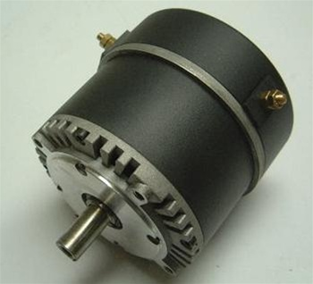
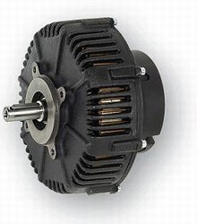
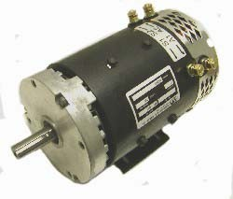
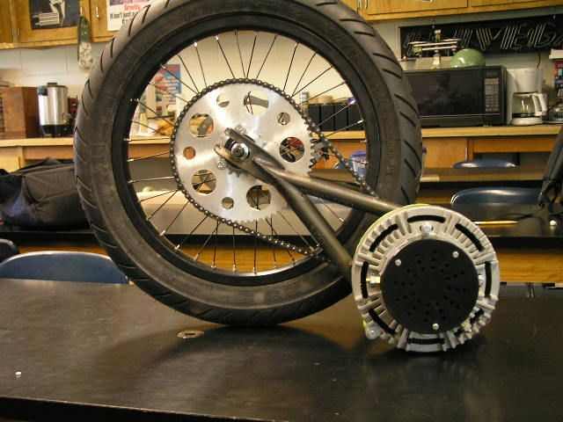
Electric Motors
Brushed Electric Motors
  Inexpensive
  Lower overall efficiency
  Controller is inexpensive and easy to wire
Brushless Electric Motors
  More efficient
  More expensive than brushed motors
  Controller is more difficult to wire (typically 3 phase)

Slide 21
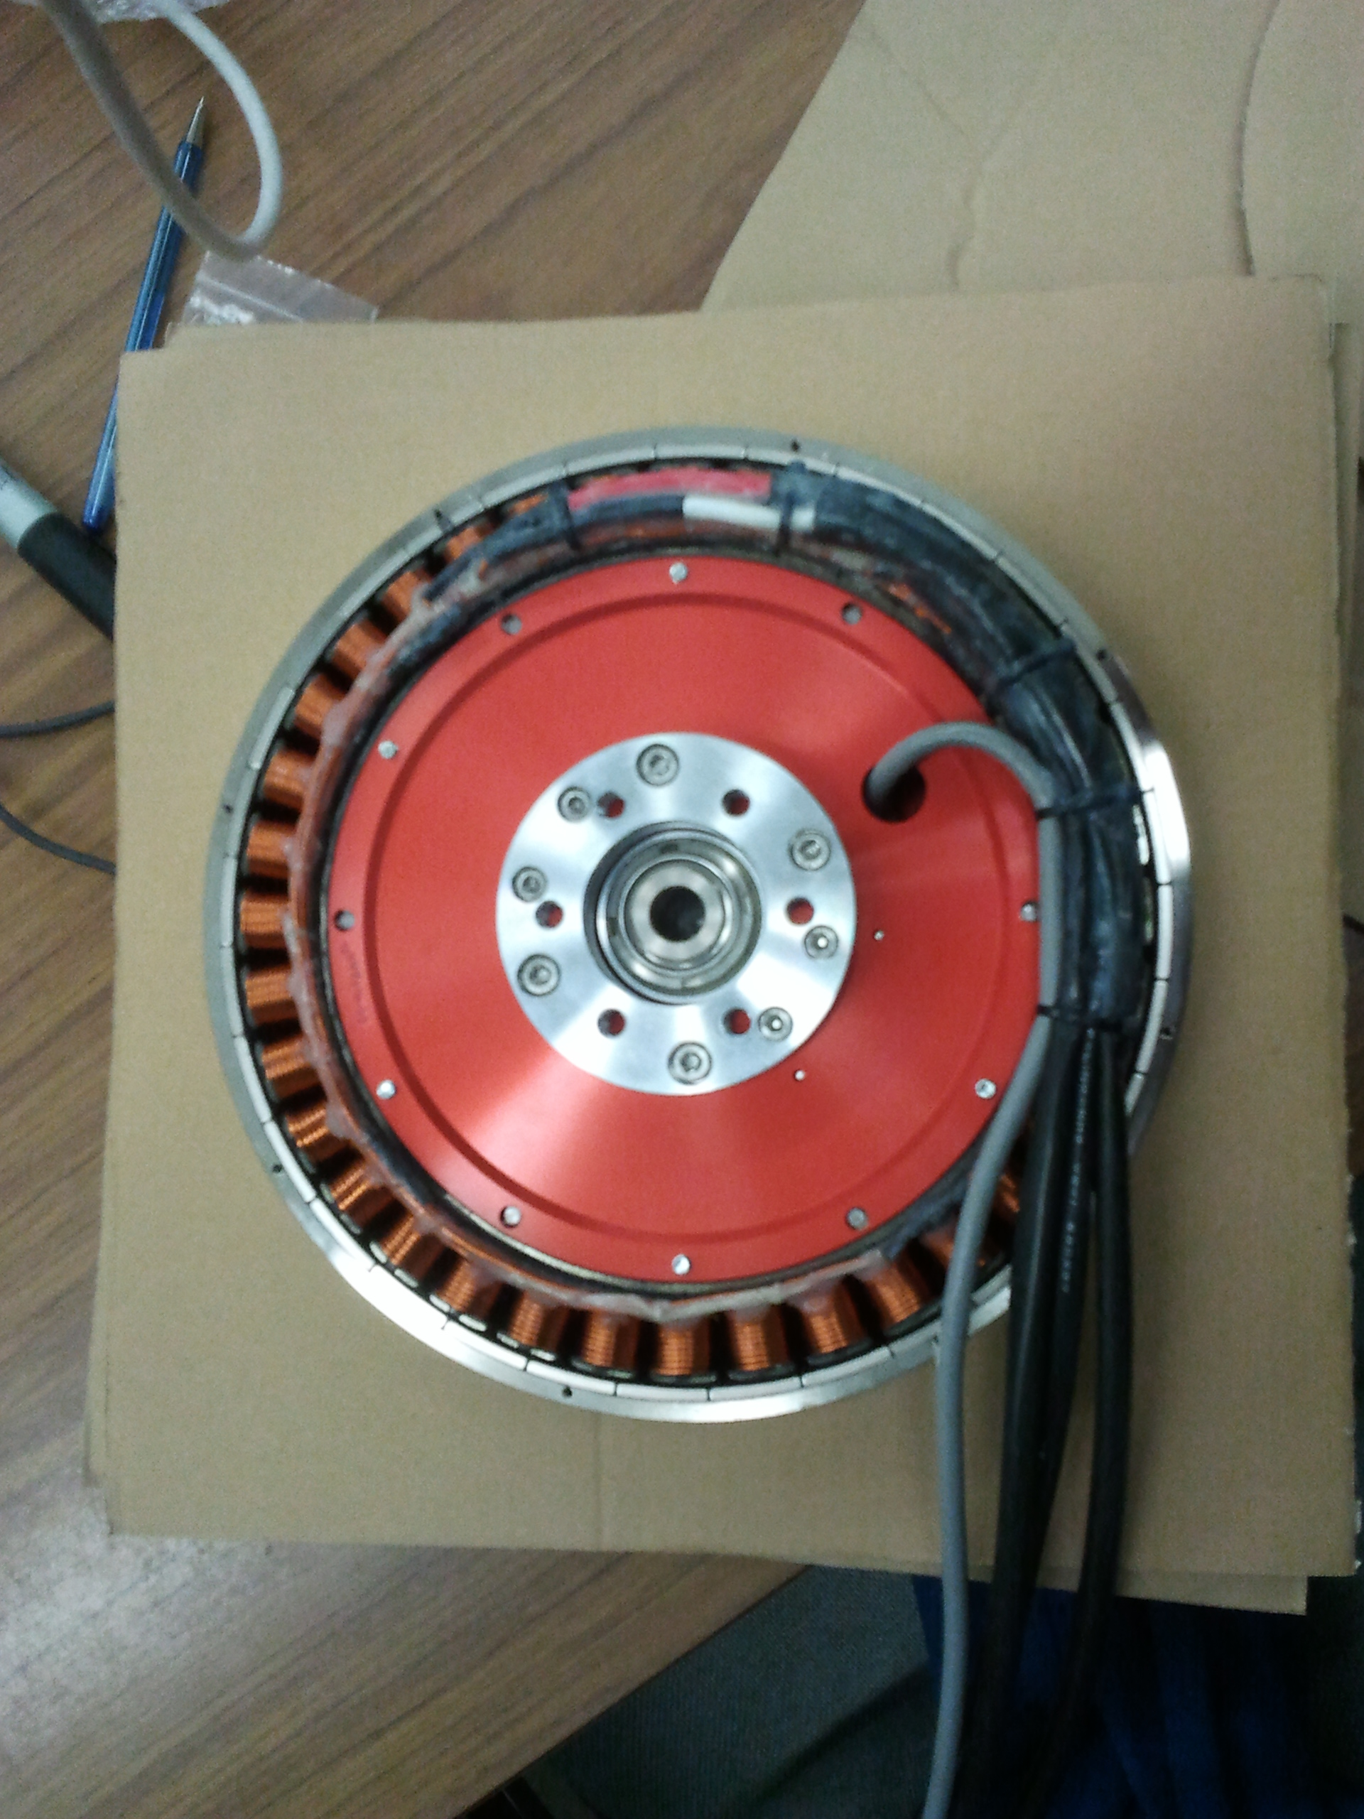
Hub Motor
NGM ‘Direct Drive’ high efficiency in-hub motor with variable air gap adjustment.
  Super efficient over a broad range of speeds
  No need for gears or chain
  Very expensive (Motor + controller > $25,000)
Mitsuba / Nomura hub motors replacing NGM as favored motor for solar car teams
  Still ~$25,000

Slide 22
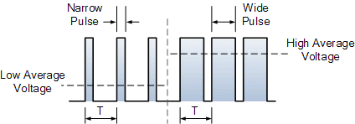
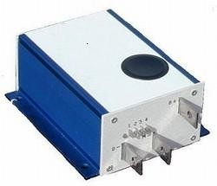
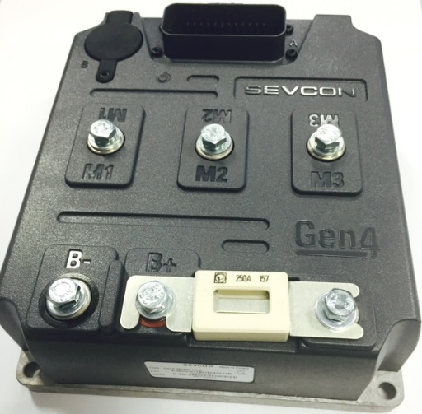
Pulse Width Modulation (PWM) Controller
Brushed Motors – Alltrax AXE
  Easy to wire
  0-5k Pot control
  Programmable
  Durable
Brushless Motors – Sevcon
  Supports 3-phase motors
  Includes safety interlocks (e.g. driver present)

Slide 23
Electrical System Overview
Solar Array
Maximum Point Power Trackers
Batteries
Motors / Motor Controllers
Other Electrical Components

Slide 24
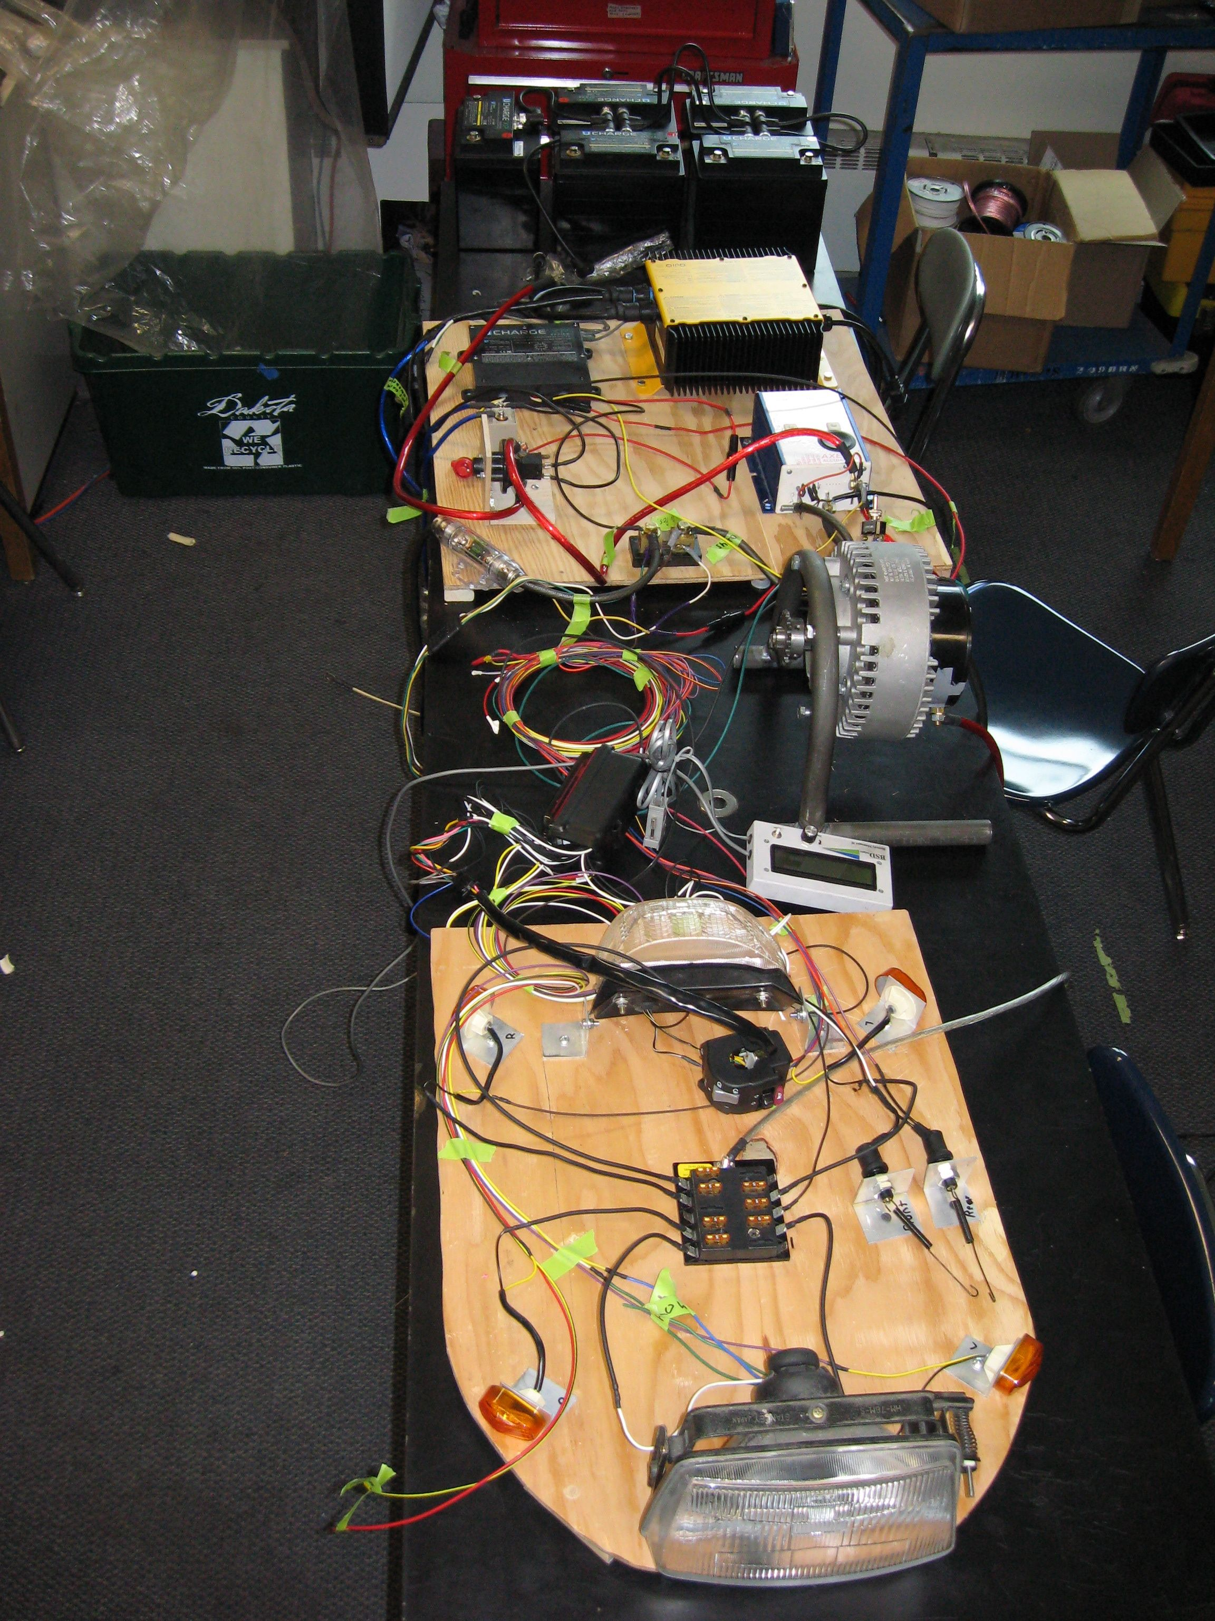
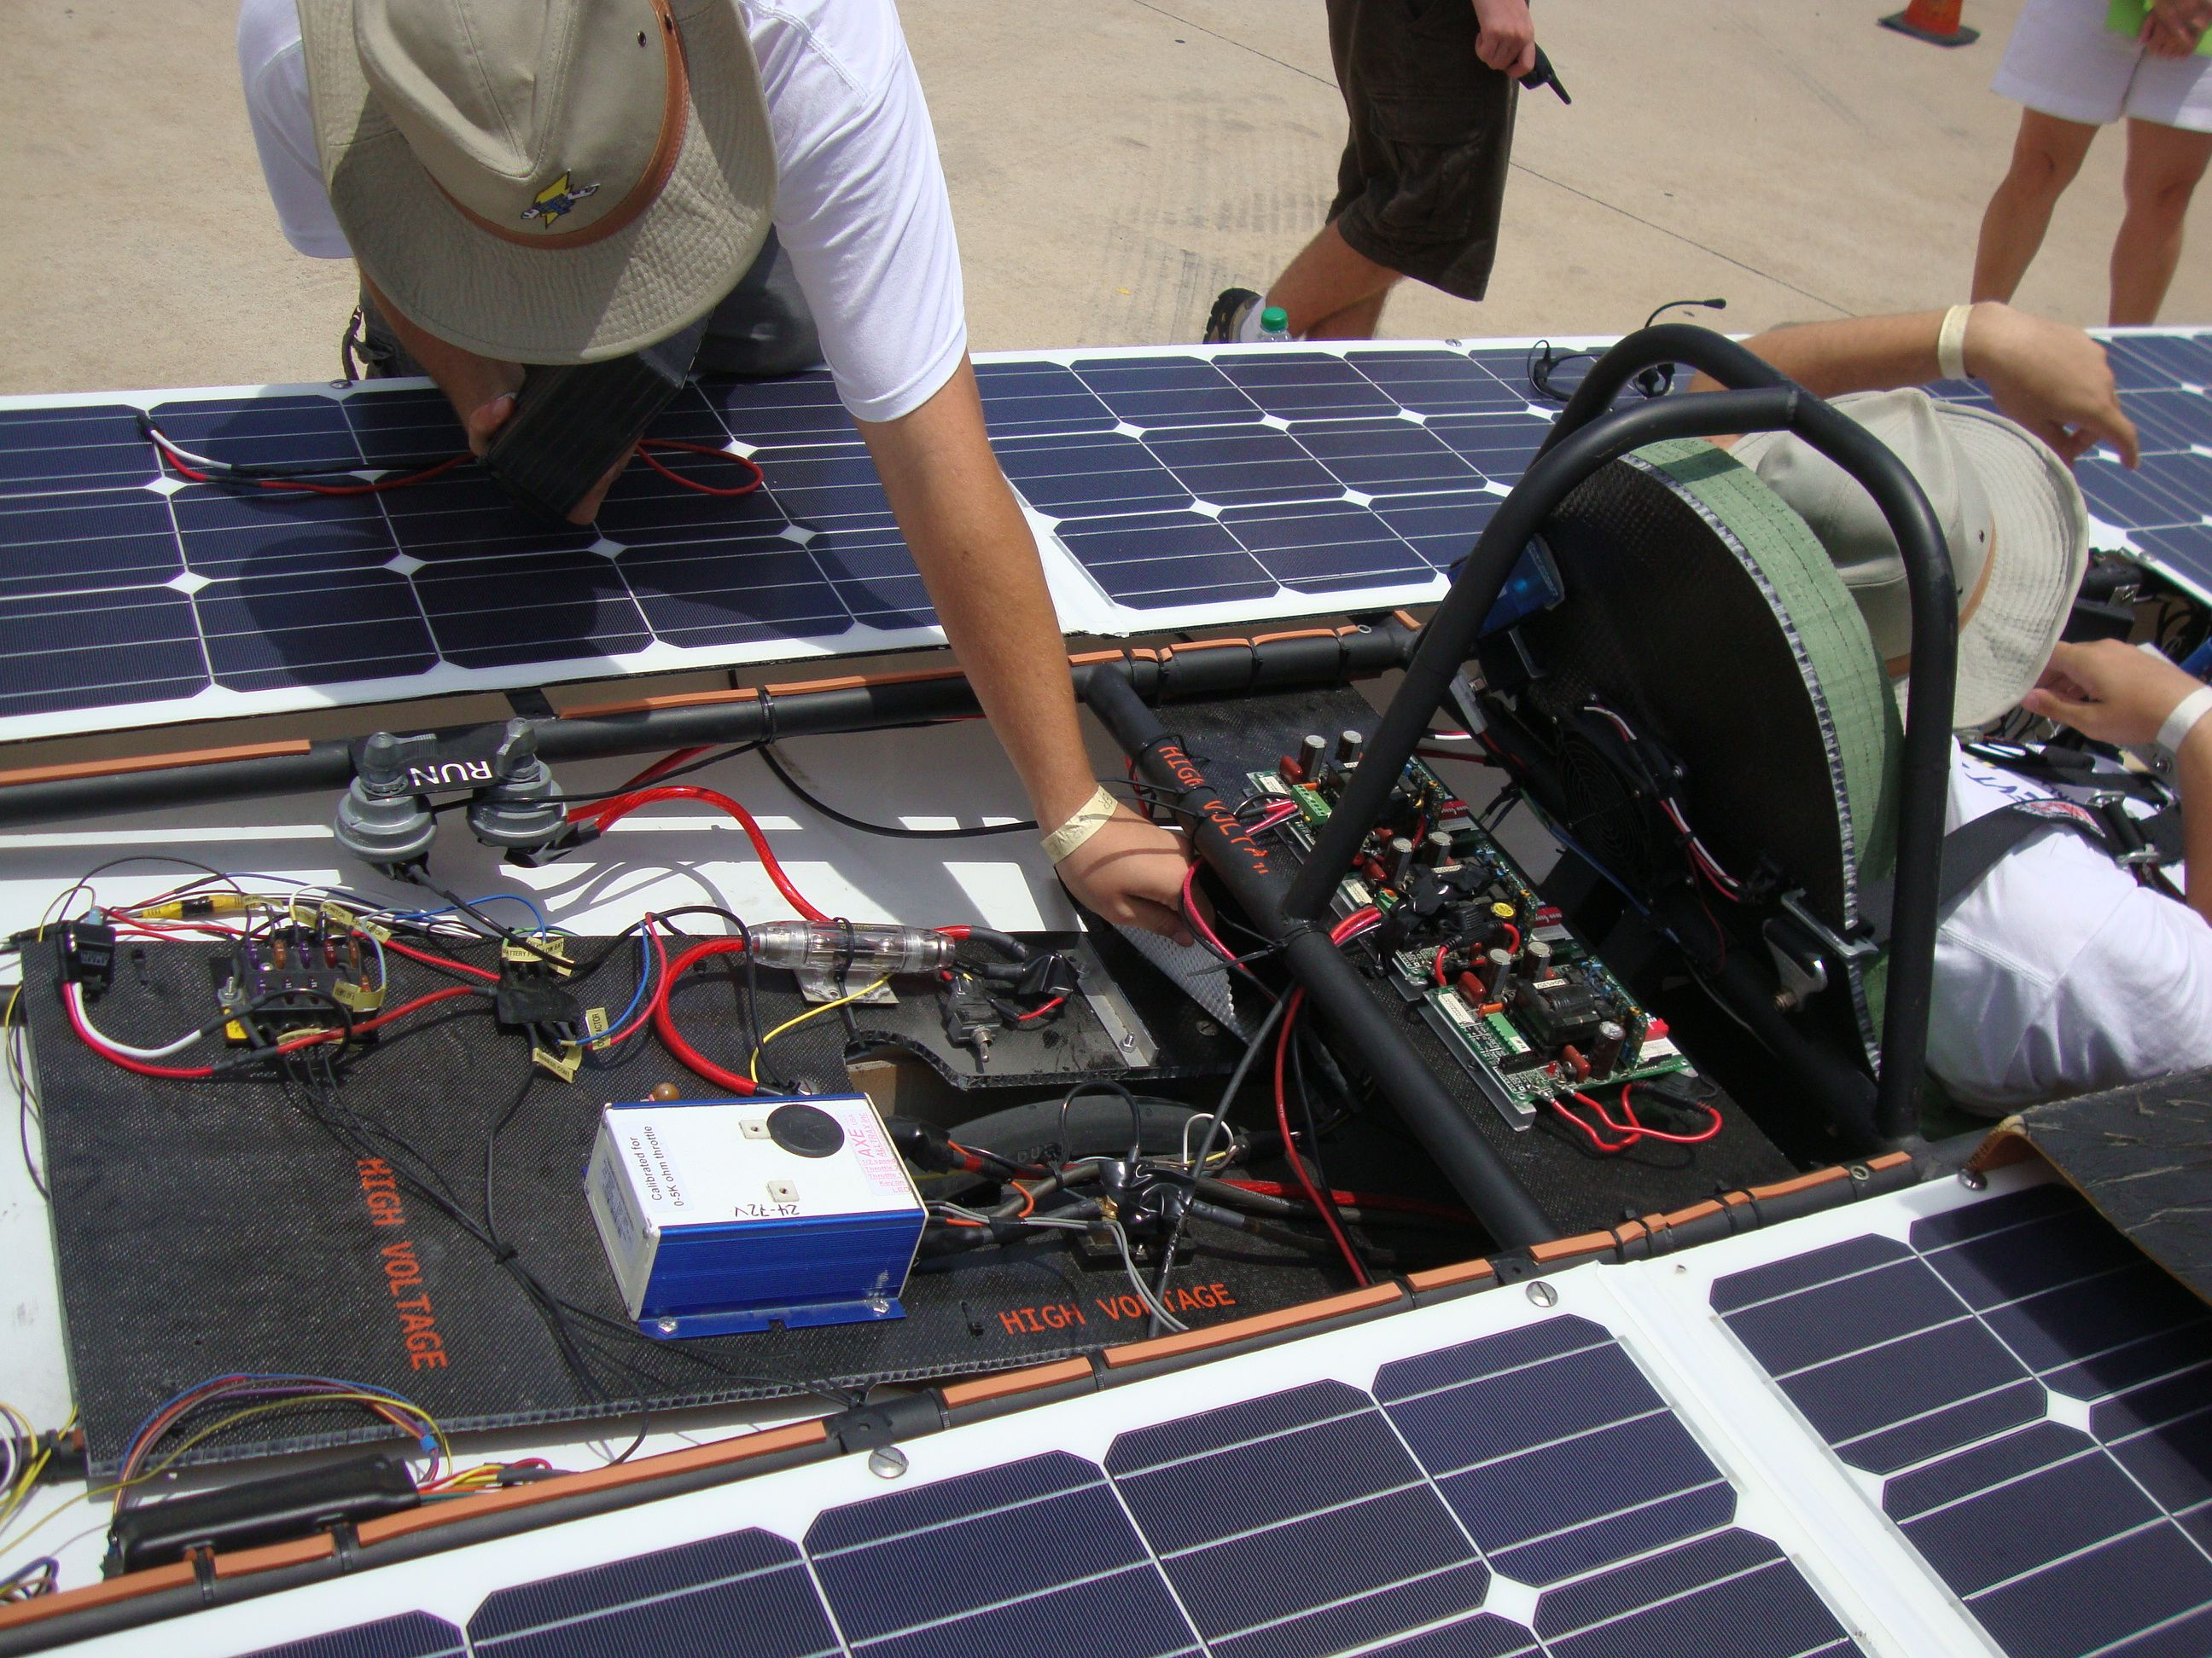
Electrical System
Main electrical system (i.e. propulsion)
(the one that makes your car move)
  Use the correct gauge wire for the job
  Disconnect switches should be designed for DC
  Fuses
Secondary electrical system
(everything else on your car)
  Lights
  Fans
  Horn
  Telemetry/Data
  Etc.

Slide 25
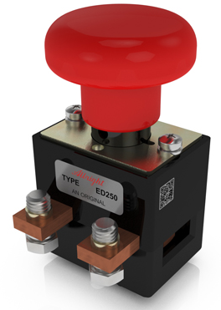
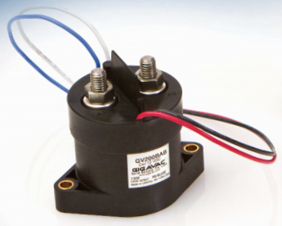
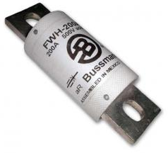
Disconnect Switches/Fuses
Disconnect Switches
  Used to operate the control signal of relays
  No longer need Albright ED250
Contactors and/or Relays
  Required as of 2022
  Can put 12V switch in driver component to control contactor coil
  Minimizes high-voltage wires around driver and length of runs
  https://springercontrols.com/news/contactors-vs-relays/
Fuses
  Need to be rated for DC and for system voltage
  Any speed fuse is now allowed (no fast-blow required)
Albright ED250
Rated load: 400 A
Break Current:
1200 A @ 48 V DC (600 A @ 96 V DC)
GigaVac GV 200
12V Coil Control Rated Load: 500+ A
Rated Voltage: 12-800 VDC
Bussman FWH Fuse
500V DC @90 amp fuse is about $50

Slide 26
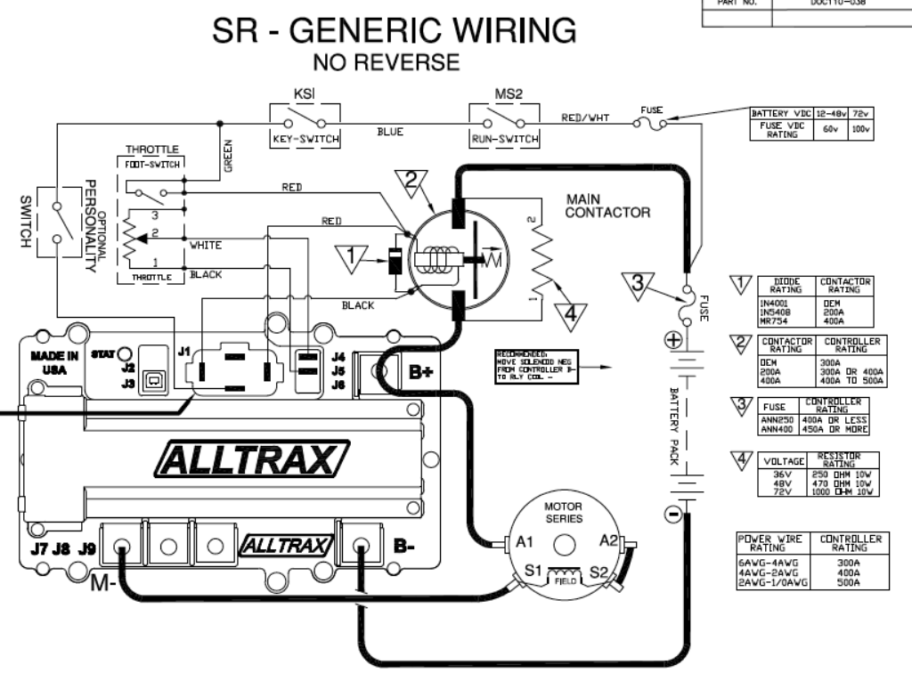
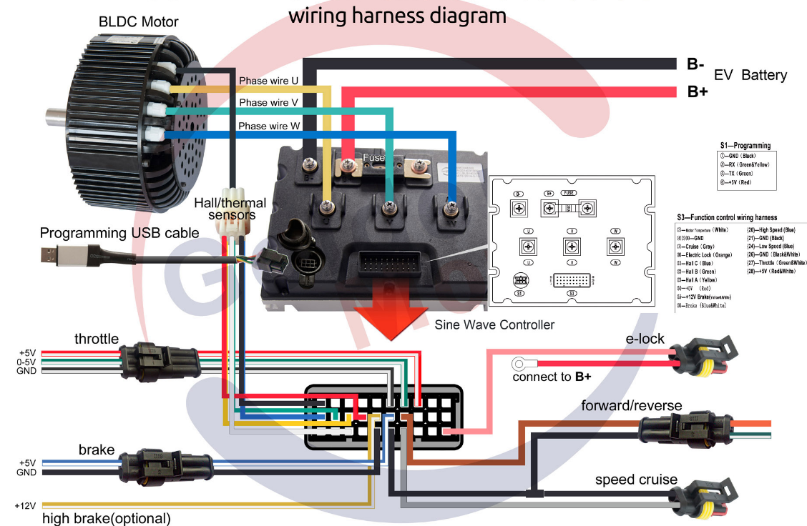
Brushed vs. Brushless Wiring
Brushed Motor Example
Brushless Motor Example

Slide 27
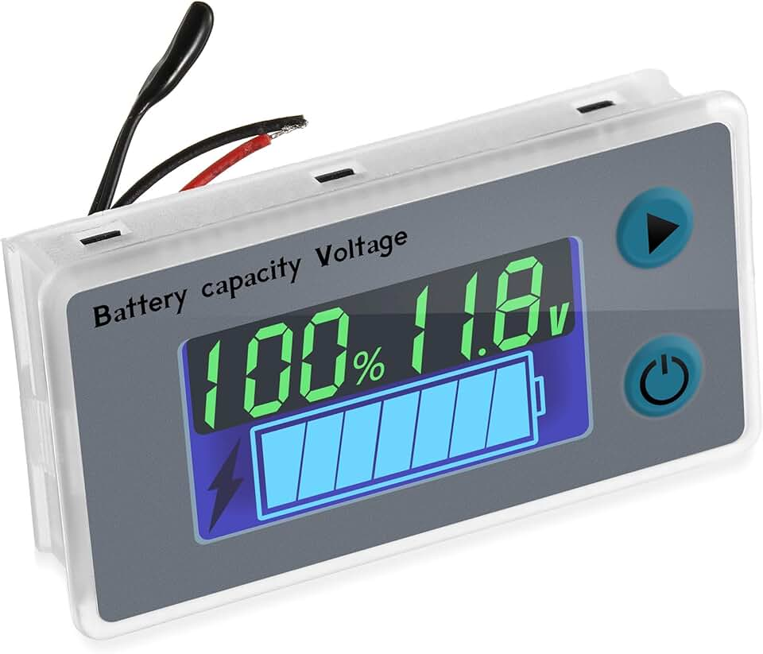
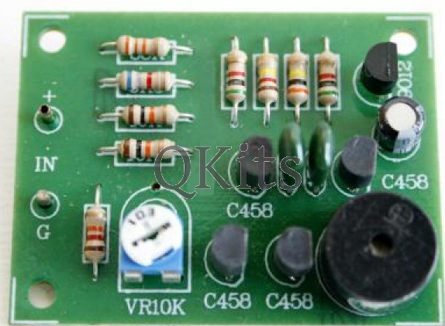
Low Voltage Indicator
Do-It-Yourself kit available at:
http://store.qkits.com/
Look for “Low Voltage Alarm”

Slide 28
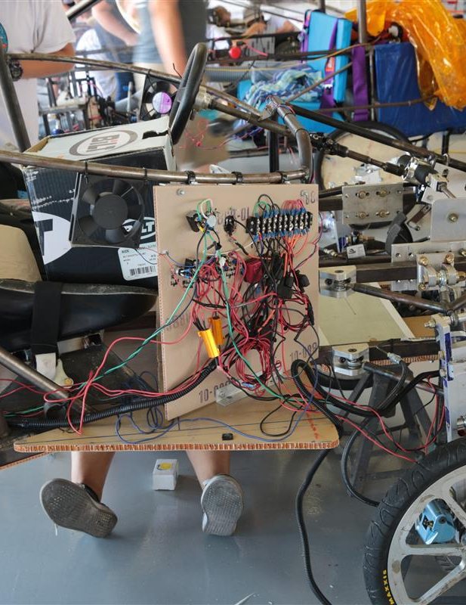
Electrical System “Gotchas”
Main Electrical System
  Loose battery terminals/connections
  Grounding to the frame (nicks in wires, bad isolation on mounting hardware)
  Wire insufficient for rated current
  Disconnects or fuses incorrectly rated
Secondary Electrical System
  Grounding to the frame (especially due to telemetry)
  Not isolated from main electrical system
  Switch reliability (especially brake switches)
  Loose connections or crimp connectors

Slide 29
Mini-Course in Electrical Engineering
Solar Car Electrical Systems,
Battery Technology, and Safety Issues
Brian Coleman, Advisor – Somerset HS, Somerset, KY

